Slide 1
How to Use win_bison & win_flex
This Presentation explains how to use win_bison and win_flex, i.e. how to generate syntax parser and lexical analyzer using win_bison & win_flex respectively.
win_bison generates syntax parser
win_flex generates lexical analyzer
By Thomas Kim
Feb. 18, 2017

Slide 2
win_bison and win_flex
In this session, we will learn
What We Should Do
What win_bison Does
What win_flex Does
How to Compile
Function Call Sequence
Make Settings in Visual Studio IDE

Slide 3
1. What We Should Do
We create 3 files and 2 functions
Lexer.l - the Flex grammar file
Parser.y - the Bison grammar file
Source.cpp, which contains
    int main()
    void yyerror(const char*)
Flex grammar file ends with .l file extension
Bison grammar file ends with .y file extension

Slide 4
2. What win_bison Does
win_bison generates two files using parser.y
parser.cpp
  contains the famous int yyparse() or is called syntax parser
parser.h
  contains tokens that are used in lexical analyzer
So, win_bison generates parser.cpp and parser.h using parser.y that we create by ourselves. parser.cpp houses int yyarse() generated by win_bison and is called syntax parser or simply the parser or just the parse. The parser.h, generated by win_bison, is used in the lexical analyzer generated by win_flex.

Slide 5
3. What win_flex Does
win_flex generates one file using lexer.y
lexer.cpp
  which houses int yylex() or called lexical analyzer
So, win_flex generates one file lexer.cpp using lexer.l in which we define lexical rules (in regular expression). lexer.cpp contains one very important function int yylex() generated by win_flex and is called lexical analyzer

Slide 6
Let’s Recap What We’ve Learned
We create 3 files
  lexer.l – which is called Flex grammar file or Flex rule file
  parser.y – which is called Bison grammar file or Bison input file
  Source.cpp – which contains int main() and void yyerror(const char*)
win_bison generates two files using parser.y
  parser.cpp which contains int yyparse() or is called syntax parser
  parser.h which contains tokens used by lexical analyzer or int yylex()
win_flex generates one file using lexer.l
  lexer.cpp which contains int yylex() or lexical analyzer
Because the lexical analyzer or int yylex() in lexer.cpp uses tokens generated by Bison, contained in parser.h, the lexer.l should contain #include “parser.h”

Slide 7
4. How to Compile
win_bison -o parser.cpp parser.y
  Compiles parser.y and generates parser.cpp and parser.h
  ( %defines “parser.h” in parser.y directs Bison to generate parser.h)
(For CL) win_flex --wincompat -o lexer.cpp lexer.l
(For g++) win_flex -o lexer.cpp lexer.l
  Compiles lexer.l and generates lexer.cpp
Finally to build myapp.exe
  using Microsoft C++ compiler (CL)
  prompt>cl /EHsc source.cpp lexer.cpp parser.cpp /Fe: myapp.exe
  using GNU C++ compiler (g++)
  prompt>g++ source.cpp lexer.cpp parser.cpp -o myapp.exe

Slide 8
5. Function Call Sequence
Source.cpp
int main()
{
yyparse();
}
void yyerror(const char*)
{
…
}
parser.cpp
int yyparse()
{
while( (token = yylex()) != 0 )
{
switch(token)
{
case rule1:
…
case rule2:
…
case rule3:
if error then yyerror(msg)
}
}
return xxx;
}
lexer.cpp
int yylex()
{
case 1:
return token1
case 2:
return token2
case 3:
return token3
…
}

Slide 9
6. Settings in Visual Studio IDE
Keep it in mind that we use win_bison to generate parser.cpp and parser.h with parser.y
For the command-line command;
win_bison -o parser.cpp parser.y
in Visual Studio, %(Identity) corresponds to parser.y
%(Filename) corresponds to parser, which means
%(Filename).cpp resolves to parser.cpp, So the command-line
win_bison -o parser.cpp parser.y
is equivalent to
win_bison -o %(Filename).cpp %(Identity)
For parser.h, it will be automatically generated by inserting the following Bison statement in parser.y
%defines “parser.h”

Slide 10
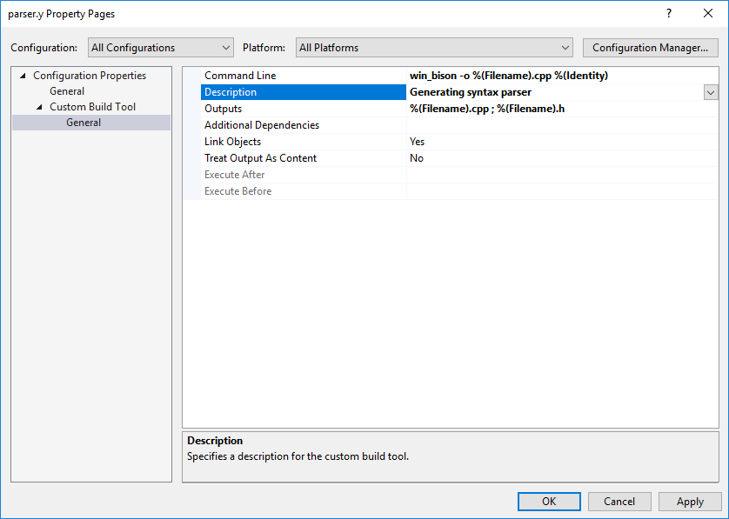
win_bison Compile Settings
Command Line:
win_bison -o %(Filename).cpp %(Identity)
Outputs:
%(Filename).cpp ; %(Filename).h

Slide 11
win_flex Compile Settings
Keep it in mind that we use win_flex to generate lexer.cpp with lexer.l
Command-line command
win_flex --wincompat -o lexer.cpp lexer.l
equivalent to
win_flex --wincompat -o %(Filename).cpp %(Identity)
The option --wincompat is for Visual C++ compatibility. For GNU g++, you should not give –wincompat switch.
The generated lexer.cpp is dependent on parser.h which is to be generated by Bison. So Additional dependencies setting (see next slide) is useful. This setting directs Visual Studio to regenerate lexer.cpp whenever parser.y is modified.

Slide 12
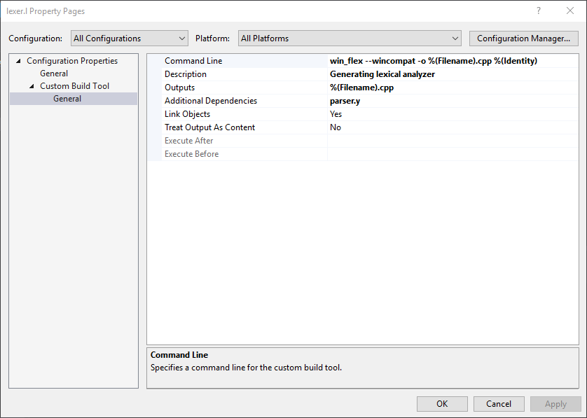
win_flex Compile Settings
Command Line:
win_flex --wincompat -o %(Filename).cpp %(Identity)
Outputs: %(Filename).cpp
Additional Dependencies: parser.y

Slide 13
Than You for Watching!
By Thomas Kim
Feb. 17, 2017
http://www.TalkPlayFun.com
http://www.TranslatosFrom.Asia
YouTube: https://youtu.be/WuXT_5SXR8g

